Slide 1
School- to-prison pipeline
By: Saniya isaac
Ctec 426
Dr. miller

Slide 2
introduction
The school-to-prison pipeline refers to how certain school disciplinary practices, like suspensions or expulsions, can push students into the juvenile justice system. Harsh discipline for minor infractions leads to missed instructional time, academic struggles, and disengagement from school. This disruption increases the chances of dropping out and getting involved in the juvenile justice system, as students may face arrests or charges for behaviors that could have been addressed in school.
To break this cycle, schools need to adopt alternative, restorative practices like counseling, peer mediation, and conflict resolution. Focusing on these methods can help prevent students from becoming involved in the juvenile justice system and prioritize their well-being, success, and future opportunities.

Slide 3

What is the Issue ?
Disciplinary actions like suspensions and referrals to law enforcement in schools can lead to increased involvement in the juvenile justice system for students. This contributes to the school to prison pipeline, affecting student's opportunities and futures.

Slide 4
Literature review
By Center for Public Justice in "Classroom Or Courtroom? Problems & Solutions To The School-To-Prison Pipeline":
"School discipline practices that rely on suspensions and expulsions contribute to pushing students out of the classroom and into the criminal justice system."
1
By Legal Defense Fund in "Case: School To Prison Pipeline":
"Many of the policies and practices that create the school-to-prison pipeline disproportionately impact students of color and those with disabilities."
2
By Learning for Justice in "The School-To-Prison Pipeline":
"The school-to-prison pipeline is fueled by the criminalization of behavior that is often the result of unmet needs or lack of support."
3

Slide 5

Problem statement
Harsh school discipline practices, like referring students to law enforcement or making arrests for minor issues, can push students toward the juvenile justice system. These actions disrupt their education, make it harder for them to succeed in school, and increase the chances of future legal problems. It's important to rethink these policies to prevent students from getting caught in this cycle.

Slide 6
Data questions
How do referral rates to law enforcement vary across different school districts and states?
Is there a significant difference in referral and arrest rates based on student demographics?
How do offense rates For vary across different school districts?
What demographic trends can be observed in sentencing practices for federal offenses?
Are there correlations between different offense types and sentencing outcomes?

Slide 7

Data source
Data Sources:
2021-22 Civil Rights Data Collection (CRDC) – Collected by the U.S. Department of Education, tracking school discipline trends.
2023 U.S. Sentencing Commission (USSC) Data – Federal sentencing data collected annually to analyze criminal case outcomes.
History of Data Collection:
CRDC:
Started in 1968 to track racial equity in schools.
Expanded over time to include discipline policies, special education access, and school resources.
Data is collected every two years from public schools in the U.S.
USSC:
Established in 1987 to ensure fair sentencing practices across federal courts.
Tracks offense types, sentencing trends, and demographic disparities.
Data is collected annually, covering all federal criminal cases processed that year.
Years of Data Available:
CRDC: Available for multiple years, including 2013-14, 2015-16, 2017-18, 2019-20, and 2021-22.
USSC: Sentencing data has been collected annually since 1987.

Slide 8
Data topics in the datasets
Overview of Topics:
CRDC
Student demographics (race, gender, disability status, etc.)
Disciplinary actions (referrals, suspensions, arrests)
Access to educational services (special education, AP courses, etc.)
School characteristics (school type, grade levels, etc.)
USSC
Federal sentencing data (sentence length, offense type, defendant characteristics)
Sentencing disparities (race, gender, prior criminal history, etc.)
Trends in federal sentencing (guideline adherence, departures, variances)
Policy analysis and reform recommendations
Years of Data Available:
CRDC data is available for various years, including 2013-14, 2015-16, 2017-18, 2019-20, and 2021-22. Dataset spans over 50 years, with annual or biennial updates.
Sentencing commission data is available annually, covering cases from fiscal years starting in 1987, with updates reflecting the latest trends and reforms.
Instance of Datasets:
Each row represents a school district or school with corresponding information on student’s demographics, disciplinary actions, and available resources.
Each row represents a federal criminal case, including information on the offense, sentence imposed, demographic characteristics of the defendant, and related sentencing factors.

Slide 9
Ingestion – the data
Portion of Data Used:
Student demographic data: This includes race, gender, and enrollment information.
Demographic data: Information related to offenders' race, gender, age, and prior criminal history.
Referrals and arrests: Data on student referrals and arrests, including breakdowns by student group such as race/sex.
Offense types: This includes data on various federal offenses and sentencing outcomes.
Sentencing data: Includes the type of sentence imposed, length of sentences, and other judicial decisions.
Enrollment data was used to calculate referral and arrest rate.
Years of Data:
I'm using the CRDC data from 2021-22 to analyze trends in student offenses, referrals, and arrests, and the USSC data from Fiscal Year 2023 to explore trends in sentencing, demographics, and offense types. Together, these datasets provide insights into changes in school discipline policies and federal sentencing practices.
Instances & Columns:
2021-22 (Referrals and Arrests): 98,011 instances and 84 columns.
2023 (Sentencing Data): 64,125 instances and 3,722 columns.

Slide 10
Final features selected
From the 2021-22 CRDC Data (Referrals and Arrests):
LEA_STATE, LEA_STATE_NAME: To analyze school discipline trends across states.
LEAID, LEA_NAME: To analyze at the district level.
SCH_NAME: To break down the analysis by specific schools within the districts.
TOT_DISCWODIS_REF_M, TOT_DISCWODIS_REF_F: Total referrals for male and female students.
TOT_DISCWODIS_ARR_M, TOT_DISCWODIS_ARR_F: Total arrests for male and female students.
From the 2023 USSC Data (Sentencing):
AGE: To focus on the 18-24 age group.
MONRACE: Race at the time of sentencing
MONSEX: Gender at the time of sentencing
CASETYPE: Type of offense or case.
CRIMHIST: Whether the individual has prior criminal history, which could influence sentencing.
SENTTOT: Total sentence length.
SENTIMP: Type of sentence imposed.
DISTRICT: District where the case was handled.

Slide 11

Final analytic dataset
Portion of Data Used:
2021-22 CRDC Data: This will cover data on school referrals, arrests, and disciplinary actions for students. I’ll focus on referrals and arrests and break them down by gender, race, and special education status.
2023 USSC Data: This will cover sentencing data, focusing on individuals aged 18-24, with a breakdown of case types, sentencing lengths, and demographics.
Number of Instances and Features:
CRDC Data: 318 instances, and 81 features.
USSC Data: 7,137 instances, and 10 features.
CRDC dataset was limited to the five selected school districts.

Slide 12

Data wrangling
Feature Engineering:
Encoding Categorical Variables:
I converted race and gender, which were initially numeric, into categorical variables.
Handling Missing Data:
I identified and handled missing values by removing the rows/columns
Age Group:
I created an age group feature 18-24, to better align with the analysis focus and ensure clarity in modeling.
Feature Selection:
I reviewed and removed irrelevant features.
Data Issues:
Handled missing data by removing unreliable entries.
CRDC Reserve Codes: Included values such as -3 (Processing Failure), -4 (Missing Data), -12 (Privacy Suppressed) to account for missing or unavailable data.

Slide 13
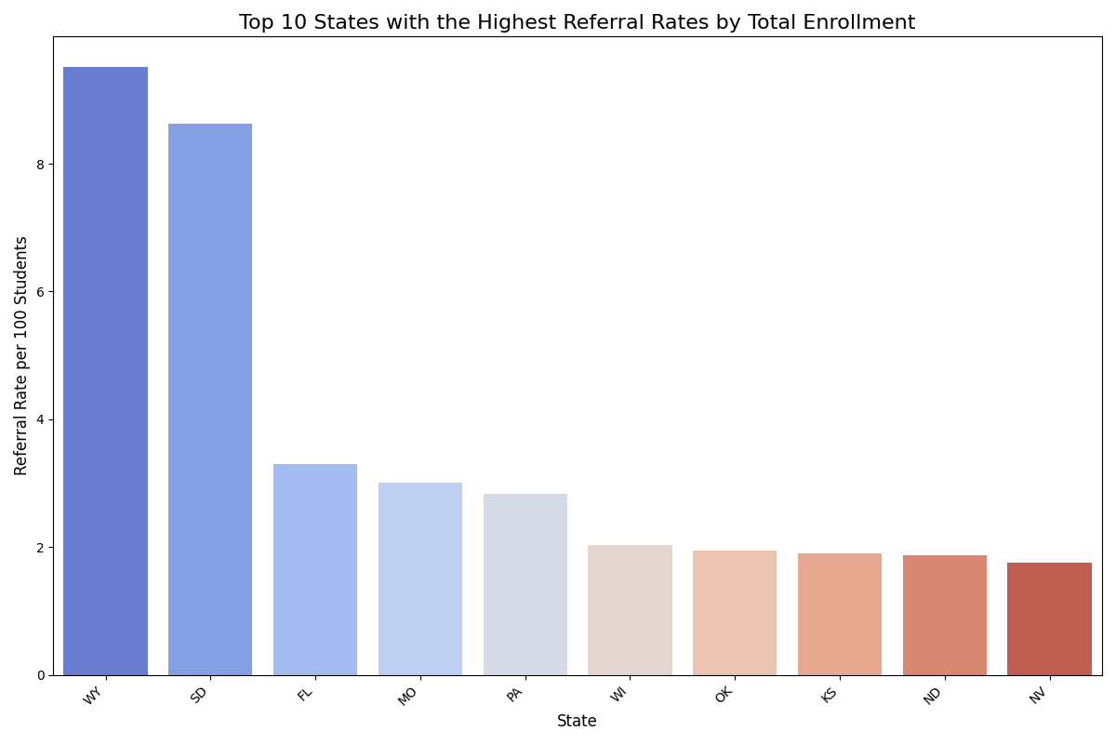
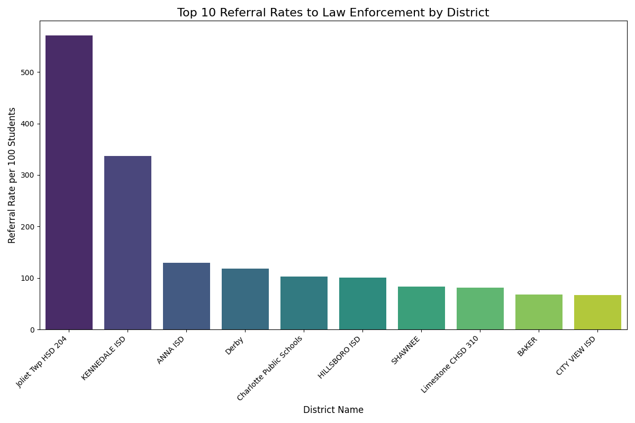
How do referral rates to law enforcement vary across different school districts and states?
This first graph shows the top 10 districts with the highest referral rates to law enforcement per 100 students, with Joliet Twp HSD 204 and Kennedale ISD having the highest rates.
The second graph illustrates the top 10 states with the highest referral rates per 100 students, with Wyoming and South Dakota leading the chart.

Slide 14
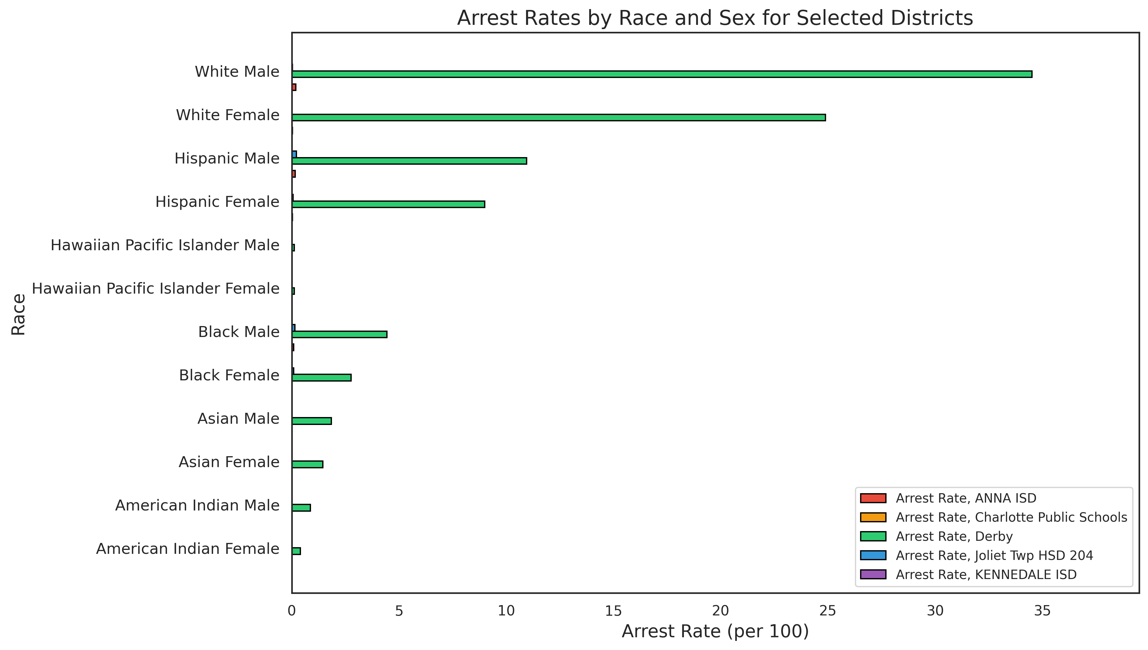
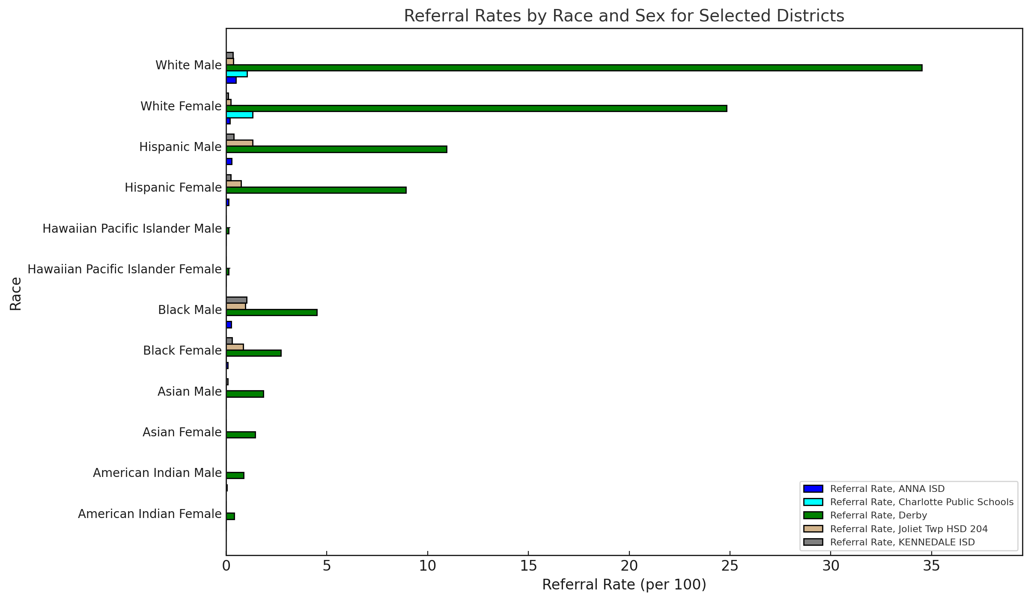
Is there a significant difference in referral and arrest rates based on student demographics?
White Male students have the highest referral and arrest rates.

Slide 15
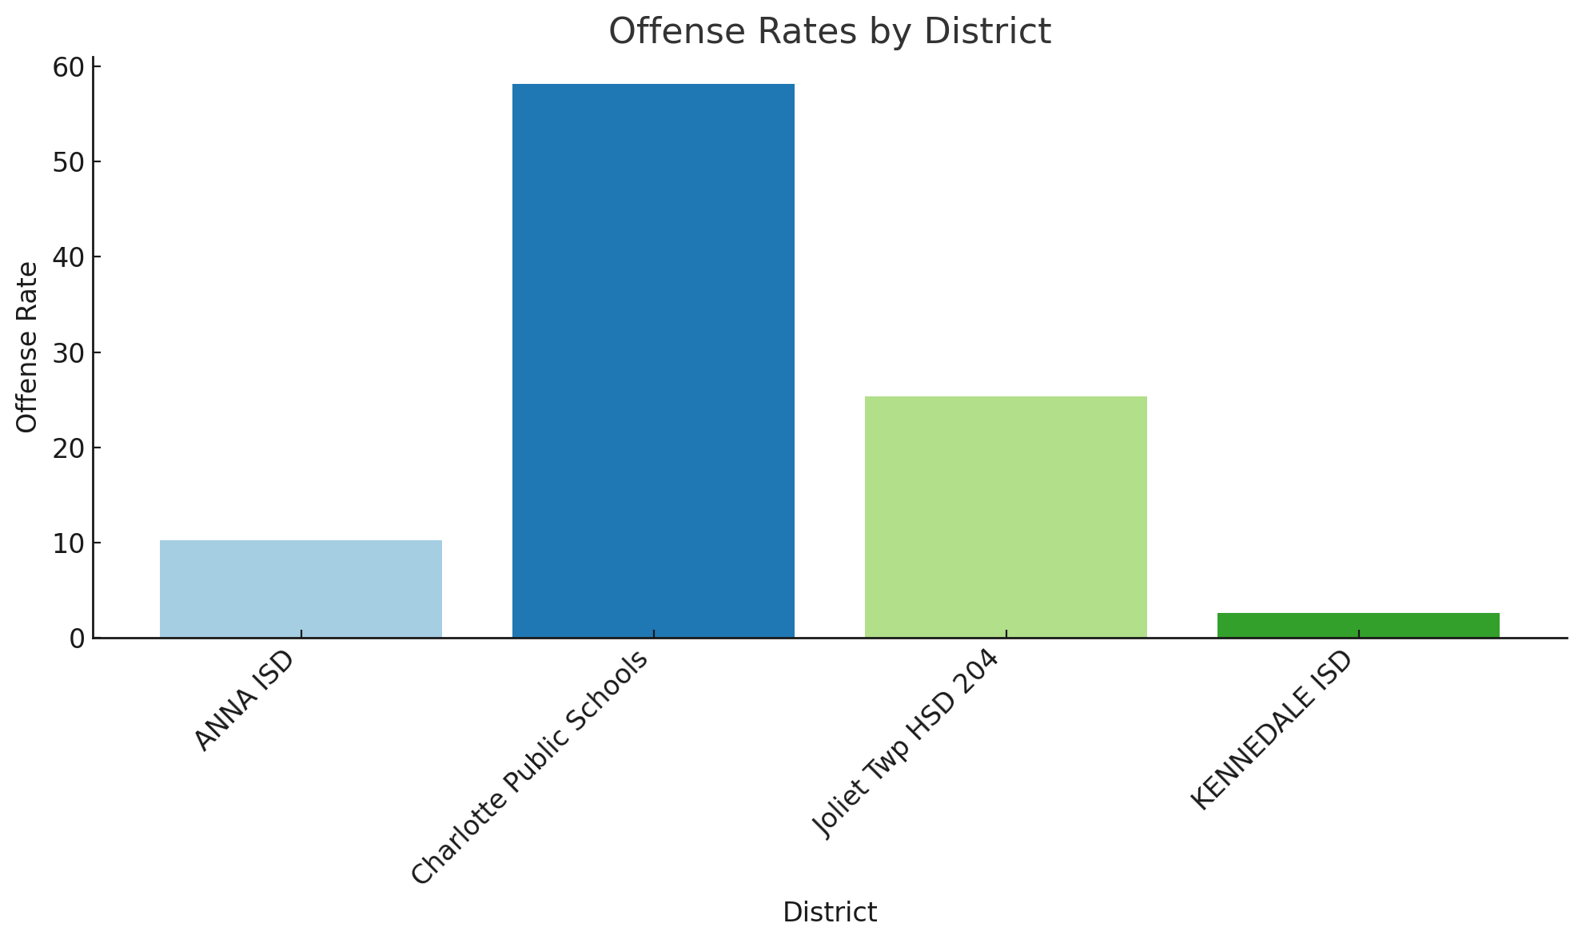
How do Offense rates For vary across different school districts?
Charlotte Public Schools has the highest offense rate, followed by Joliet Twp HSD 204. Anna ISD and Kennedale ISD have the lowest offense rates

Slide 16
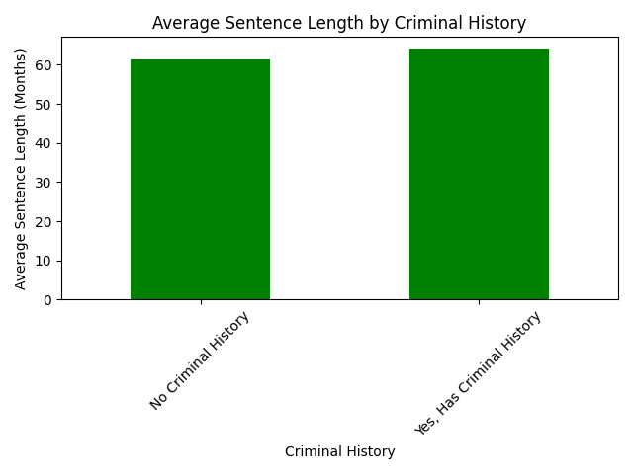
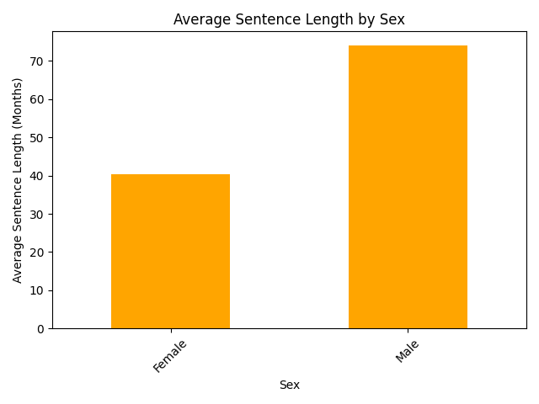
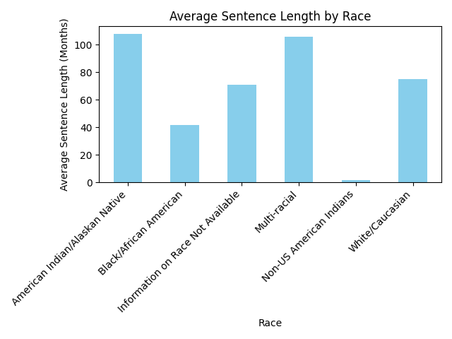
What demographic trends can be observed in sentencing practices for federal offenses?
The graphs show average sentence lengths across selected federal districts (Texas North, Illinois North, Missouri East, Kansas, and Michigan East). They highlight how sentence length varies by criminal history, sex, and race. Males and those with criminal histories generally receive longer sentences, while American Indian/Alaskan Native and Multi-Racial groups tend to have longer sentences than others.

Slide 17
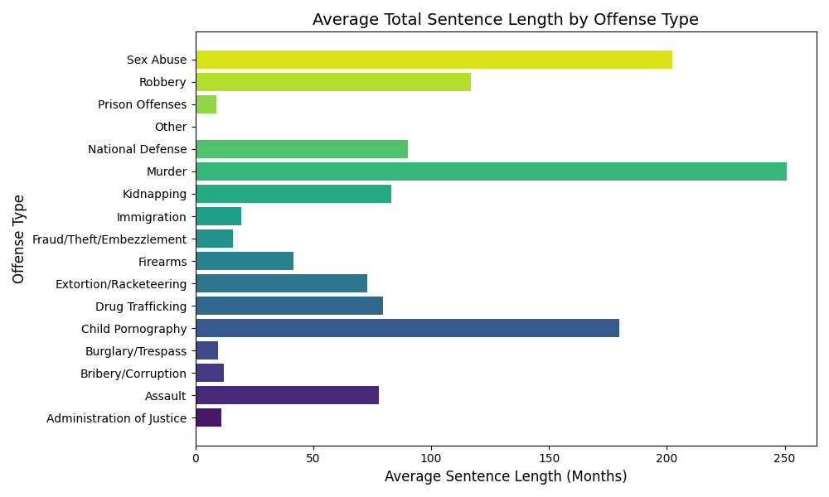
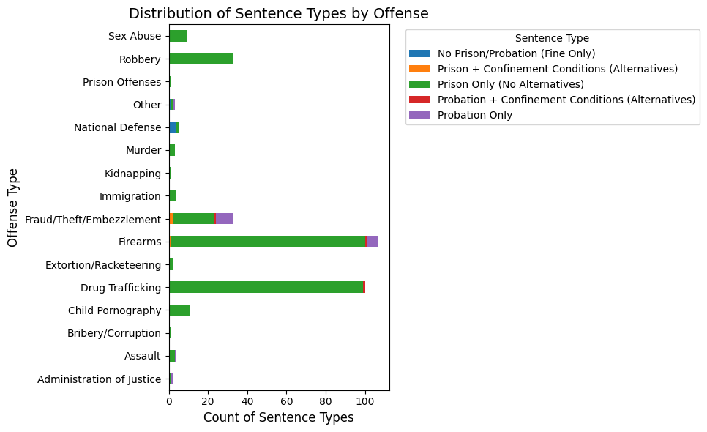
Are there correlations between different offense types and sentencing outcomes?
The graphs show that offenses like murder and sex abuse have the longest average sentences, while crimes such as drug trafficking, robbery ,and firearms often receive prison-only sentences, and fraud offenses are more likely to result in probation or alternative sentences.

Slide 18
Data insights
What did I learn?
In the five school districts (Joliet Twp HSD 204, Kennedale ISD, Anna ISD, Derby, and Charlotte Public Schools), White and Hispanic students had the highest referral rates.
Men in Texas North, Illinois North, Missouri East, Kansas, and Michigan East receive much longer sentences than women (74 months vs. 40 months).
Murder, Sex Abuse, and Child Pornography have the longest sentences, while financial crimes often result in probation.
Most crimes lead to prison time, with very few cases resulting in only fines or probation.
Actionable Insights:
Sentencing policies in the five districts should be analyzed to address disparities in gender and race-based sentencing outcomes.
More alternative sentencing options should be available for non-violent offenders in these regions.
Restorative justice programs in schools could help lower the rate of referrals and arrests.
Realistic Steps:
Train school staff and officers on fair discipline practices.
Reevaluate sentencing guidelines in Texas North, Illinois North, Missouri East, Kansas, and Michigan East to ensure fairness.
Support community-based diversion programs for youth.

Slide 19
Project challenges
Challenges Faced:
I had trouble deciding on a specific social issue to focus on at the start of the project.
Finding relevant datasets that correlated with my issue was challenging.
What I Would Do Differently:
Research other available datasets before finalizing my topic to ensure there is enough data to analyze.
Explore broader connections between different datasets to strengthen the analysis.
What I Would Do With More Time:
Analyze districts with low referral and arrest rates to understand what policies or practices contribute to fewer law enforcement interactions.
Compare trends over multiple years to see if referral and arrest rates are improving or worsening.
Look deeper into the sentencing process.

Slide 20
Future projects
Suggestions for Future Data Analytics Projects:
Explore how school funding affects referral and arrest rates.
Analyze the impact of alternative discipline programs on student outcomes.
Examine how sentencing varies based on legal representation and plea deals.

Slide 21
references
Fabelo, T., et al. (2011). Breaking Schools' Rules: A Statewide Study of How School Discipline Relates to Students' Success and Juvenile Justice Involvement.
Skiba, R. J., & Peterson, R. L. (2011). Teaching the Social Implications of School Discipline: A Review of Evidence.
American Civil Liberties Union (ACLU). The School-to-Prison Pipeline: The Impact of School Discipline Practices.
EdWeek. (2023). I Combed Through 81 Studies on School Discipline. Here's What Educators Need to Know.

